Slide 1

IMDB Movie Analysis
Final Project 1
By - Tanish

Slide 2
Project Description:
Provided with dataset having various columns of different IMDB Movies. You are required to provide a detailed report for the data record mentioning the answers to the questions that follows.
Clean the data as necessary, and use your Data Analysis skills to explore the data set and derive insights.
Five 'Whys' approach.

Slide 3
Approach:
Five 'Whys' approach.
Cleaning data (Dropping columns, removing null values, etc.)
Created the Database and Tables: Created a database and then the tables using the structure and links provided.
Perform Analysis: Joined the data bits and structured the tables to derive business insights, used pivot tables, fetched the required results and hence, created useful insights for the company to take calculated and planned decisions

Slide 4
Tech-Stack Used:
Software And The Version Used While Making The Project :
1. MS Office Excel (For working, analysing and reporting insights)
2. Microsoft Power Point (For presenting the detailed analysis

Slide 5
Data Analytics Tasks->

Slide 6
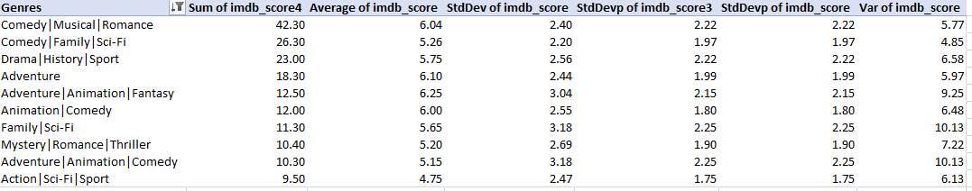
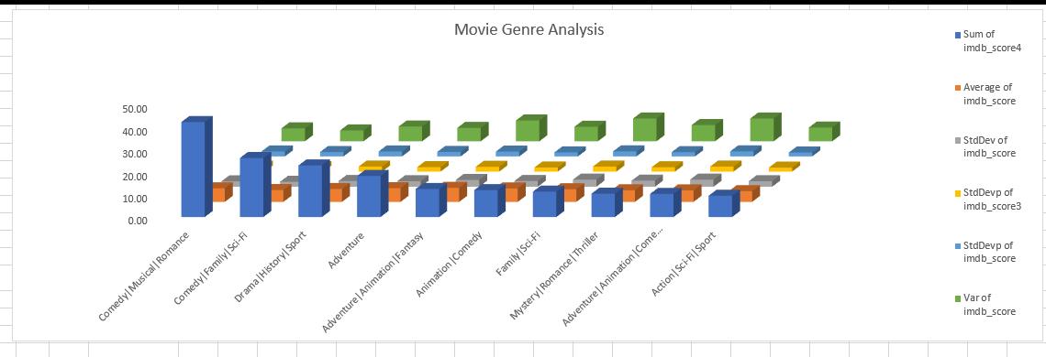
A. Movie Genre Analysis:
Descriptive Statistics
Graphical Representation
‘Drama’ is the most common genre.

Slide 7
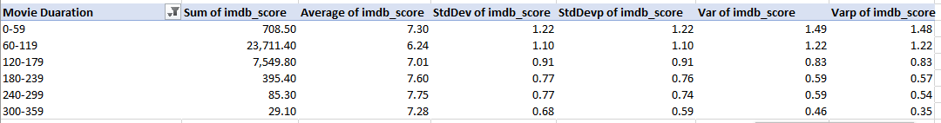
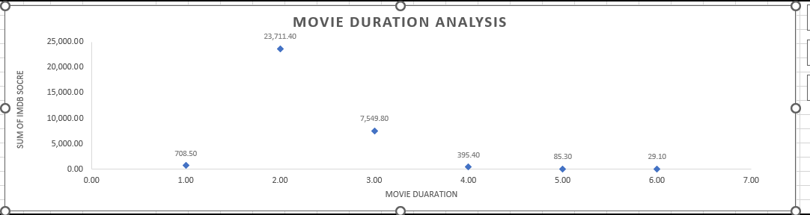
B. Movie Duration Analysis:
Descriptive Statistics
Scattered Plot
Movie having time duration between 60-119 minutes are having highest imdb score.

Slide 8
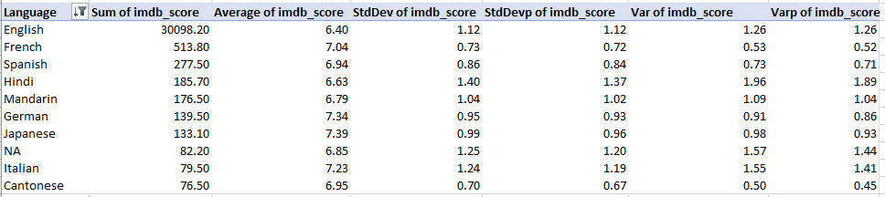
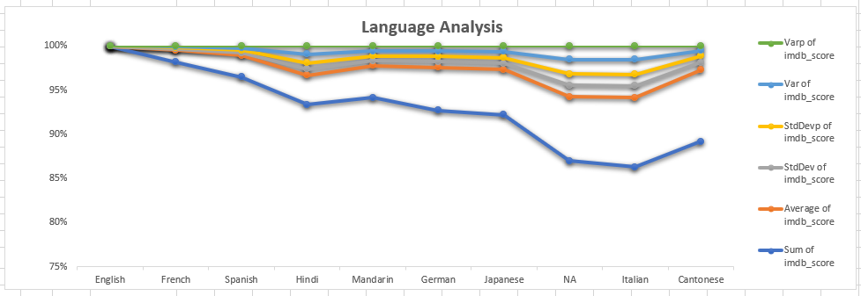
C. Language Analysis:
Descriptive Statistics
Graphical Representation
‘English’ is the language having highest imdb score.

Slide 9
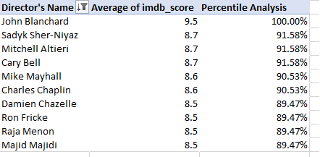
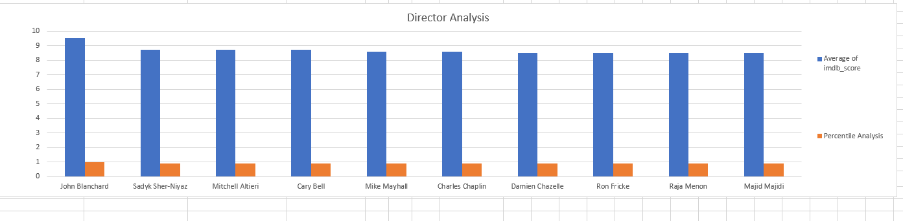
D. Director Analysis:
Graphical Representation
John Blanchard is the director with highest imdb score.

Slide 10
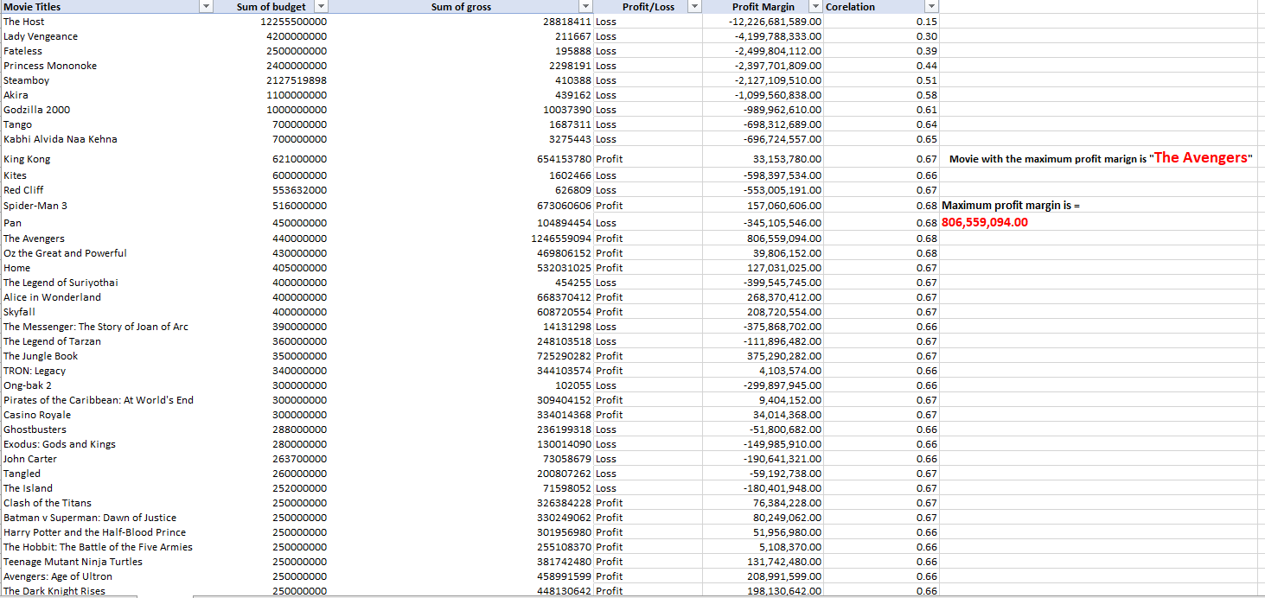
E. Budget Analysis
‘The Avengers’ is the movie with maximum profit margin i.e., 806,559,094.00

Slide 11
INSIGHTS:
Cleaning data is a crucial part of data analysis.
Profit – Budget Analysis is having one outlier.
Avatar is the highest IMDB rating movie.
Punch Drunk Love is the highest IMDB rating movie in English language.
Creative control is the highest IMDB rating movie in foreign language except English language i.e. Italian.
Highest IMDB score Director is Steven Spielberg.
Most Popular genre is Drama.
The Avengers is the movie with maximum profit margin.
Each decade the voters increased.
The critic and audience – favorite actor is Johnny Depp.

Slide 12
Result:
Understanding of cleaning and modifying data is very important.
Removing unnecessary data i.e. columns, blank spaces or cells, etc. makes the data much more readable.
Outliers identification and removal changes the results of data analysis.
• Presenting data with charts and graphs makes it look way more interesting and clear.

Slide 13
Excel Sheet Link:
https://docs.google.com/spreadsheets/d/15a_AdU8s-e0xRqWPf2j2gaqhQqqXxDJo/edit?usp=drive_link&ouid=116128795062416707309&rtpof=true&sd=true
Video Presentation Link:
https://drive.google.com/file/d/1usBixZ1ah4N-E0Fek1C3vtj1ywHEx47N/view?usp=sharing

